Slide 1
Likelihood of Violence at Protests
Author: Peter L’Oiseau

Slide 2
Outline
Problem Statement & Data
Defining Success
Analysis of Data
Evaluation of Results
Recommendations and Next Steps

Slide 3
Motivation
Affected Parties
Context
Problem Statement
Protests as a form of activism can be seen all through history and across the globe. So, the issue of violence occurring in this setting is one which can affect every government and citizenry.
Citizens have been demonstrating against their government since humans began organizing governments as a method to advocate for the popular will in a visible manner.
These occasionally result in violence from the state and/or protester side which results in tragic loss of life and suffering and only further exacerbates tension between the two sides.
Notes:
Protests have affected all sorts of governments and citzeneries.
Protests are one of the most important tools ordinary people have to effectuate change in the world around them.
When these become violent there is humanitarian concerns for the people and lives; there is also increased tensions between the two sides of the protest.
FInding a way to reduce the problem of violence in the protest setting could facilitate a more peaceful and amicable relationship between people and government.

Slide 4
Data
The data provided by the Mass Mobilization Project (1) has information from 15,239 distinct protests from 1990 to 2020 in 166 countries.
United States of America, Israel and some smaller countries are absent in the data.
The data has information on the start and end dates of the protest, the identity of the protesters, how many protesters there were, the location, whether the protesters were violent, what demands they made and how the state responded.
Notes:
Mass Mobilization project provides data from 1990-2020 about protests around the world outside USA, Israel and some smaller countries.
Info on when, where, who, how many people, what the demands are, and how the state responded.
We can conclude which protests are violent and which side(s) participated in the violence.

Slide 5
Success Criteria
Aim to build a system which can accurately predict the likelihood of violence occuring at a given protest.
Governments could effectively triage violence mitigation resources to protests which are more likely to become violent.
Test for accuracy and balance the system’s ability to detect non-violent protest (specificity) and how often it finds protests which actually did become violent (sensitivity).
Notes:
I want to build a model for predict violent protests.
This would allow governments to respond to protests with a better sense of what is likely to occur.
Test this model by measuring its accuracy.
As well as its ability to recognize violent (sensitivity) and non-violent protests (specificity) balanced in ROC AUC
I will also consider its rate of successful predictions of violence (precision)
And its rate of violent protests found (recall) balanced in harmonic mean (F1)

Slide 6
Analysis Plan
Factors
Model
Evaluate
Recommend
Explore the variables which potentially contribute the likelihood of violence at protests.
Develop a system which tests the efficacy of these factors and the value they may hold.
Investigate the quality of the model for our purposes and determine its utility.
Conclude about what factors matter in predicting protest violence and grapple with the consequences.
Notes:
Which variables may matter? Length/ size of protest, how many demands/ what are the demands, where is the protest occurring?
Build a model which allows the interpretation of the parameters for future action
Test which model is best and how reliable it is for prediction
Discuss what factors matter and why they matter. Then rely the utility of such a model for making better decisions about resource allocation for state actors to reduce violence and foster a better relationship with citizens.
This is just one tool in the toolbelt for this issue. Understanding more about what resources can help de-escalate tensions at a high-risk protest is also important but understanding which protests are likely to be violent will at least put a state in a position to act accordingly.

Slide 7
Factors

Slide 8
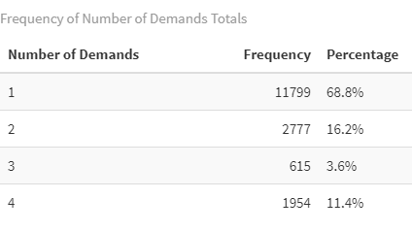
Protesters
Data set contains information on approximately how many protesters were at the protests, what demands they were making and how many demands they made.
Most common demand of protesters (58%) by far is related to some political behavior or process.
Notes:
There are a significant number of protests with multiple demands (31.2%)
Entire list of demand categories includes:
Political behavior/ process
Labor wage disputes
Removal of politician
Price increase/ tax policy
Police brutality
Social restrictions
Land farm issues
Note, ¼ protests result in violence from protesters and violence is defined as violence from either side.

Slide 9
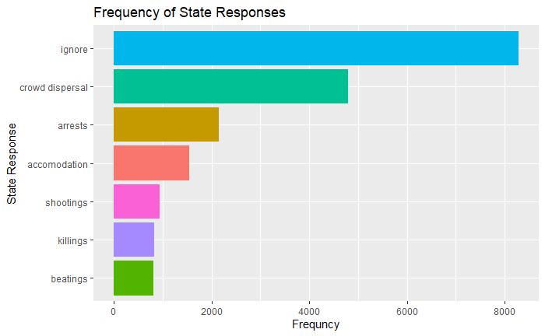
State Response
In each protest, there are between 1 and 7 categories listed as a state response.
Most commonly, they are ignored, but violent actions by the state such as: killings, beatings and shootings occur at 1 in 8 protests.
Notes:
Killings, beatings and stabbings considered as violent, not arrests or crowd dispersal.

Slide 10
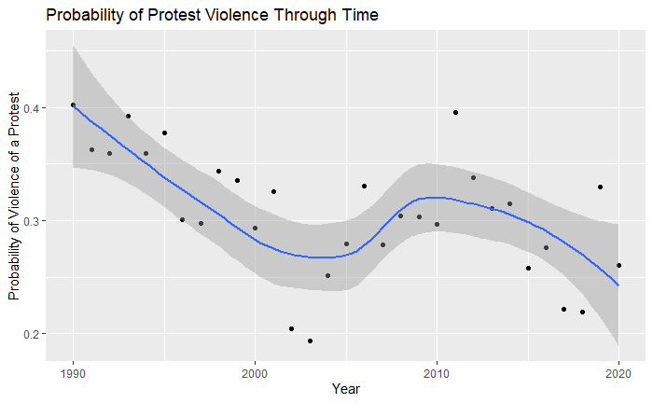
When and Where
When and where a protest happens can also tell us a lot about whether a protest is likely to be violent.
Nestled inside the when and where is information about the socio-economic and political state of a country or region
Violence at protests varies over time.
Notes:
When and where can help us understand the conditions of a country or region
More useful might be the style of government, whether a country is at war/ civil war, economic conditions, civil liberties issues, foreign occupation.
However without that available, we can use when are where to pool information about protest violence across a country or region
To acknowledge the reality that social activism and causes spread through populations as visibility increases.

Slide 11
Model

Slide 12
Estimates and Uncertainty
With 75% of the protests, I use the variables to calculate the estimated effect these variables have on violence at protests.
Use these estimated effects to predict the likelihood of violence at the remaining 25% of protests
Gives an estimate of how accurate the model is and thus how confident we ought to be when using it for decision making.
Notes:
Train a model to predict the effect each variable has on violence
Test it to see how well it can predict the future
This gives us a confidence level for how good the system is

Slide 13
Potential Assumptions
There were four models tested which made different assumptions about the effect country and region have on the likelihood of violence at a protest.
I.e. an individual country or region:
always has the same effect on violence.
has an effect on violence which may vary between protests in that country or region.
has an effect on violence which may vary with respect to time in a correlated fashion.
has an effect on violence which may vary with respect to time in a uncorrelated fashion.
Notes:
Population of a country or region has a fixed effect on violence.
Subject specific effect of country/ region on violence.
More violent countries/ regions get more/less violent over time and less violent countries/ regions get less/more violent over time.
Country/ region effect on violence can change over time but not necessarily in one direction or another.

Slide 14
Evaluate

Slide 15
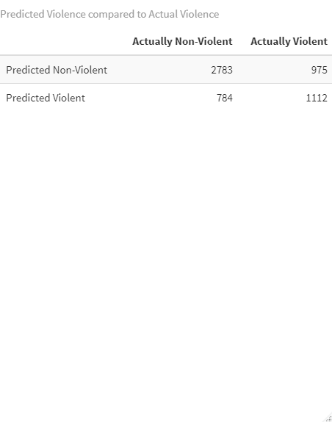
Testing Assumptions
Assumption 3 creates the most accurate model with an accuracy of approximately 70%.
This model is also able to detect approximately a little more than truly violent protests and is almost 60% accurate when it predicts violence.
Here are the predictions compared to the reality of the protests.
Notes:
Best model assumes violence of a country or region is correlated with time.
Specifically, a country or region’s effect on violence regress to the mean over time.
70% accurate.
53% of violent protests found predicted with 58% accuracy

Slide 16
Factor Effects
Longer and larger protests are more likely to become violent.
More protest demands imply higher likelihood of violence.
Protests over police brutality are more likely to be violent.
Protest over social restrictions are less likely to become violent.
When and where are significant predictors of violence at a protest.
But a there are several other important factors.
Notes:
Longer and Larger protest as well as high demand protests are more likely to be violent.
Protest demands specifics matter as well:
Police brutality .89
Price increase/ tax policy .61
Land farm issues .55
Political behavior/ process .39
Removal of politician .35
Labor wage disputes 0
Social restrictions -.52

Slide 17
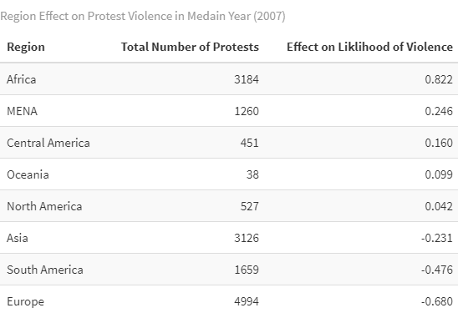
Geographical Effects
Looking at the region of a protest can inform our expectations as well
Notes:
Africa and the Middle East regions are most likely see violence while South America and Europe are less so
Note United States absence here likely makes a difference for North America
These effects however are just the group averages in the year 2007 and do indeed change over time

Slide 18
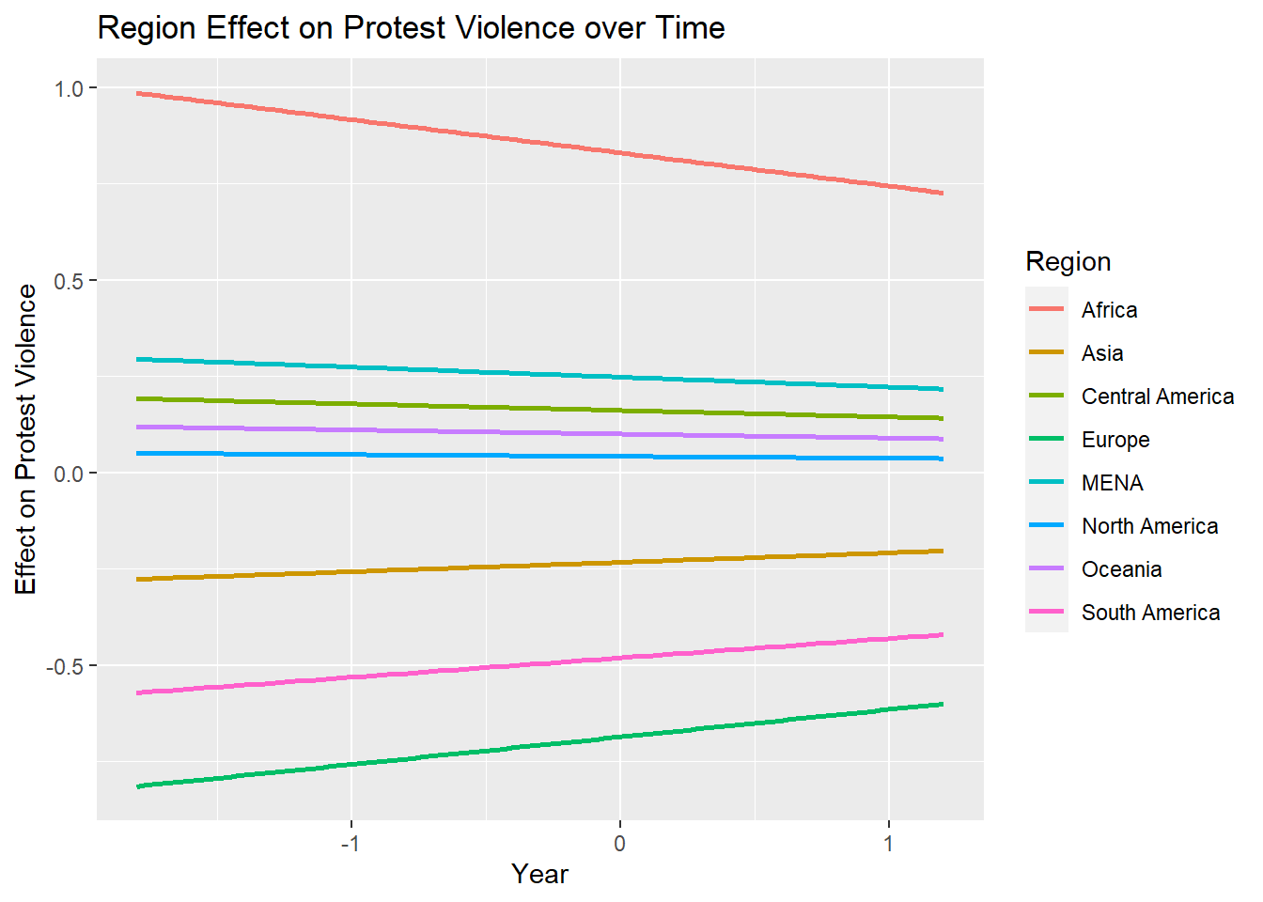
Time and Region
Indeed, the effect regions and countries have on protest violence change over time.
In fact, they tend to regress to the mean.
Notes:
This tendency to regress to the mean is true both region and country.
The less violent countries like Cuba, Japan and Ireland see more violence over time and more violent countries like Guinea, Haiti and Guyana see less.
This is a classic quantitative finding which is counterintuitive to our bias to believe that trends are likely to continue when in fact they are more likely to
regress to the mean instead.

Slide 19
Recommend

Slide 20
Summary
Longer and larger protests with more demands are more likely to result in violence.
What protesters are demanding tells us whether there is more likely to be violence.
When and where a protest takes place tells us about the social climate and help us predict violence.
The effects of a country or region regress to the mean over time.
Notes:
Big protests with many demands which span days/ weeks/ months are more likely to see violence.
Certain demands can tell us how likely we are to see violence, i.e. police brutality (more), social restrictions (less)
Country/ region and time can implicitly tell us about violence
However these geographical effects regress over time

Slide 21
Implementation
This system could be used to estimate whether an upcoming or ongoing protest is likely to be violent.
A government could then plan their response accordingly.
Protests with higher risk of violence could be identified ahead of time to triage resources which could reduce this risk of violence.
There are likely interventions possible which makes the likelihood of violence decrease.
Notes:
Proactive estimation
Allows for more informed response to protests
Triage resources such as police, politicians, social workers, people of influence to protesters, diplomats.
We can also learn from the fact that states and regions levels of protest violence change over time and that means there is likely interventions possible which makes the likelihood of violence decrease. This implies state agency.

Slide 22
Future Research
Discover what conditions of a country/region make them more/less likely to see violence.
Economic
Political
Social
Religious
Natural
Research what interventions are likely to decrease violence when conditions of high risk exist.
Notes:
Can GDP, governmental system or natural disaster tell us more about which countries and regions are likely to see violence at protests
What can we do lower the risk of violence when high risk exists (large/ long protest with many demands)
Yet three interactions are outstanding in their relevance for keeping protests peaceful: good police management, respect for territorial boundaries, and communication between protesters and police during the protest (see also Madensen and Knutsson, 2011).

Slide 23
References
59 Clark, David Regan, Patrick David H. Clark Political Instability Task Force / CIA 2016-01-13 2016 V5 protests demonstrations event Harvard Dataverse https://doi.org/10.7910/DVN/HTTWYL doi/10.7910/DVN/HTTWYL

Slide 24
Thank You!

